Slide 1



OPERATIONAL EXCELLENCE IN
OFFICE ADMINISTRATION
Tailored for the International Institute of Tropical Agriculture (IITA)
MAY 2026

Slide 2

Welcome, Everyone!
Thank you for being here and committing to this two-day programme.
  • We acknowledge the remarkable work IITA delivers across Africa and beyond.
  • Your role as administrators is vital in enabling research, operations, and institutional excellence.
  • Today, we set a tone of professionalism, respect, engagement, and shared learning.
Operational Excellence begins with mindset and clarity.
This programme is designed with you and for you.
Notes:
WELCOME, EVERYONE! (Expanded Version)
Warm Welcome & Appreciation
Good morning once again, and a very warm welcome to each of you.
Thank you for making the time to be here for this two-day capacity-building programme on Operational Excellence in Office Administration. Your presence shows commitment not only to your personal growth, but also to the advancement of IITA’s mission.
Recognition of IITA’s Esteemed Work Across Africa
IITA continues to play a transformational role in agricultural research across Africa—advancing food security, empowering farmers, influencing policy, and strengthening livelihoods. Behind every scientific breakthrough, successful partnership, donor engagement, field activity or research milestone, there are administrative professionals who ensure that operations run smoothly, efficiently, and with integrity.
Importance of Administrators in Enabling Research Impact
Administrators are not merely support staff; you are strategic enablers.
You are the ones who make research possible.
You create order from complexity.
You ensure accuracy, documentation, coordination, communication, scheduling, logistics and compliance—without which research cannot move forward.
Every form completed, every meeting coordinated, every travel arranged, every document processed, every communication clarified contributes directly to IITA’s success and credibility with partners and donors.
Tone-Setting for the Programme
This programme is designed to be:
Engaging – we will learn together through discussions, scenarios and practical exercises.
Respectful – your experiences and expertise matter and will shape our conversations.
Professional – the tools we will explore are aligned with global best practices and tailored to IITA’s unique environment.
Talking Points (OY) – Expanded
“Operational Excellence begins with mindset and clarity.”
This means excellence is not just about doing tasks—it begins from how you think about your role, how you show up daily, and the clarity you bring to processes, communication and service. With the right mindset, even complex tasks become manageable.
“This programme is designed with you and for you.”
Every module, scenario, and example has been customised to reflect IITA’s realities.
The challenges you face, the demands from researchers and managers, donor expectations, and the unique operating environment have all been considered.
This training is built around your needs, your roles, and your contributions.

Slide 3
QUESTION
What does operational excellence mean to you personally?

Slide 4
What Is Operational Excellence?
Operational Excellence is the ability of an organisation—or an individual—to consistently deliver high-quality results by doing the right things, the right way, every time.
It is a disciplined approach to working smarter, reducing waste, improving processes, and maintaining a high standard of performance.
In simple terms:
Operational Excellence means everything works well, works efficiently, and works consistently—regardless of who is on duty.

Slide 5




Why We Are Here
Why Operational Excellence Matters at IITA
  To support complex, multi-country research operations
  To lift the standard of internal service delivery
  To ensure accuracy, timeliness, and professionalism in all tasks
  To enhance collaboration with researchers, scientists, donors & partners
  To reduce process delays and administrative bottlenecks

Slide 6



TRAINING GOALS FOR THE NEXT 2 DAYS
By the end of this training, participants will be able to:
  Understand Operational Excellence in a research-driven institution
  Improve administrative efficiency and workflow quality
  Strengthen communication & stakeholder engagement
  Apply best practices in accuracy, documentation & professionalism
  Build a mindset of service excellence
  Identify improvement opportunities within your units
  Develop a practical action plan for operational excellence at IITA
Notes:
Facilitator Tip:
Connect each objective to familiar IITA work realities (procurement, workshops, documentation, travel, reporting, etc.).

Slide 7



STRUCTURE OF THE PROGRAMME (2 DAYS)
  9 Core Sessions
  Highly interactive delivery
  Group work, scenarios, role plays, real IITA examples
  Reflection and personal accountability exercises
  Practical tools you can implement immediately
NOTE: Full Two-day agenda overview chart is in your workbook

Slide 8
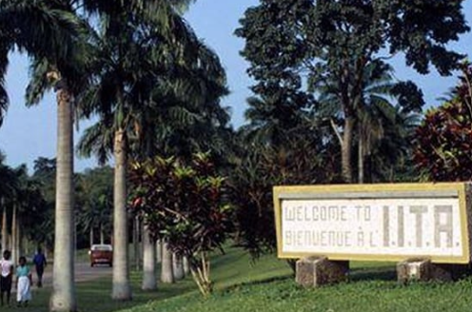
THE IITA CONTEXT
Understanding IITA’s Operating Environment:
  Multi-stakeholder ecosystem: researchers, partners, donors, governments
  Donor-funded operational standards & compliance expectations
  High need for efficiency, reliability, and accuracy
  Dependence on effective administrative support to meet deadlines, project milestones & documentation needs

Slide 9
Expectations From You (Participants)
What we expect during this training:
Willingness to examine current habits
Full engagement & participation
Openness to learning and self-reflection
Contribution of real experiences
Commitment to trying new methods

Slide 10
What Participants Can Expect From Us (Facilitators)
We will provide:
Real IITA scenarios and examples
Practical, relevant tools
Clear action steps you can implement immediately
Respectful and engaging facilitation
A safe learning space

Slide 11

GROUND RULES FOR A SUCCESSFUL SESSION
  Respect for diverse roles and experiences
  Active participation
  Phones on silent (urgent calls outside)
  Time management: we start and end on time
  Confidentiality and professionalism

Slide 12
ICEBREAKER ACTIVITY
Title: My Role, My Impact
Instructions:
  Please share ONE administrative challenge you currently experience. From the items listed on the next page, select the option that best describes the challenge you identified -
  Share ONE thing you enjoy about your work (Positive experiences). Also mention from the items listed on the next page.
  Drop your responses in the chat box.
Notes:
Debrief:
Highlight themes: communication gaps, workload, delays, accuracy demands, etc.
A. POSSIBLE ADMINISTRATIVE CHALLENGES (Grouped into 8 Headings)
1. Communication Gaps
Unclear instructions
Delayed feedback
Misunderstood requests
Inconsistent messaging between departments
2. Workflow & Process Inefficiencies
Repetitive manual tasks
Lack of standard operating procedures (SOPs)
Task duplication
Slow approval processes
3. Time & Priority Management Issues
Competing urgent requests
Interruptions and distractions
Poor task scheduling
Difficulty determining what matters most
4. Resource & Tools Constraints
Inadequate office supplies or outdated tools
Limited access to technology
Slow systems or poor internet connectivity
Lack of user-friendly platforms for documentation
5. Stakeholder Management Difficulties
Challenging personalities
Managing expectations from researchers, donors, vendors, and managers
Pressure from multiple directions
Handling complaints or dissatisfaction
6. Documentation & Record-Keeping Problems
Missing files
Poor archival systems
Incomplete or inaccurate documentation
Difficulty tracing information
7. Capacity & Skill Gaps
Limited training opportunities
Gaps in digital literacy
Insufficient knowledge of best practices
Inability to adapt to new administrative tools
8. Stress, Overload & Emotional Pressure
High workload
Tight deadlines
Burnout risks
Feeling undervalued or overextended
B. WHAT CAN BE ENJOYED IN THE WORKPLACE ADMINISTRATIVELY (Grouped into 8 Headings)
1. Effective Communication & Clear Direction
Clear instructions
Regular updates
Open-door communication
Direct, respectful feedback
2. Smooth, Efficient Processes
Well-designed workflows
Faster approvals
Reduced duplication and delays
Automation of routine tasks
3. Supportive Work Environment
Helpful colleagues
Cooperative teams
Encouraging supervisors
Respect for diverse roles
4. Reliable Tools & Resources
Functional office equipment
Good internet and systems
Access to digital tools
Adequate supplies to do the job well
5. Professional Growth & Learning Opportunities
Skills development training
Exposure to new tools and systems
Coaching and mentorship
Opportunities to take on higher responsibilities
6. Recognition & Appreciation
Feeling valued by colleagues and supervisors
Acknowledgment of good performance
Positive reinforcement
Celebrating team accomplishments
7. Job Confidence & Clarity
Knowing expectations
Understanding one's role clearly
Confidence in processes and support systems
Working with predictable standards
8. Work-Life Balance & General Well-being
Reasonable workload
Structured work hours
Lower stress levels
A healthy, positive work atmosphere

Slide 13
POSSIBLE ADMINISTRATIVE CHALLENGES
POSITIVE EXPERIENCES
1. Communication Gaps | 5. Stakeholder Management Difficulties
2. Workflow & Process Inefficiencies | 6. Documentation & Record-Keeping Problems
3. Time & Priority Management Issues | 7. Capacity & Skill Gaps
4. Resource & Tools Constraints | 8. Stress, Overload & Emotional Pressure
1. Effective Communication & Clear Direction | 5. Professional Growth & Learning Opportunities
2. Smooth, Efficient Processes | 6. Recognition & Appreciation
3. Supportive Work Environment | 7. Job Confidence & Clarity
4. Reliable Tools & Resources | 8. Work-Life Balance & General Well-being
Notes:
Debrief:
Highlight themes: communication gaps, workload, delays, accuracy demands, etc.
A. POSSIBLE ADMINISTRATIVE CHALLENGES (Grouped into 8 Headings)
1. Communication Gaps
Unclear instructions
Delayed feedback
Misunderstood requests
Inconsistent messaging between departments
2. Workflow & Process Inefficiencies
Repetitive manual tasks
Lack of standard operating procedures (SOPs)
Task duplication
Slow approval processes
3. Time & Priority Management Issues
Competing urgent requests
Interruptions and distractions
Poor task scheduling
Difficulty determining what matters most
4. Resource & Tools Constraints
Inadequate office supplies or outdated tools
Limited access to technology
Slow systems or poor internet connectivity
Lack of user-friendly platforms for documentation
5. Stakeholder Management Difficulties
Challenging personalities
Managing expectations from researchers, donors, vendors, and managers
Pressure from multiple directions
Handling complaints or dissatisfaction
6. Documentation & Record-Keeping Problems
Missing files
Poor archival systems
Incomplete or inaccurate documentation
Difficulty tracing information
7. Capacity & Skill Gaps
Limited training opportunities
Gaps in digital literacy
Insufficient knowledge of best practices
Inability to adapt to new administrative tools
8. Stress, Overload & Emotional Pressure
High workload
Tight deadlines
Burnout risks
Feeling undervalued or overextended
B. WHAT CAN BE ENJOYED IN THE WORKPLACE ADMINISTRATIVELY (Grouped into 8 Headings)
1. Effective Communication & Clear Direction
Clear instructions
Regular updates
Open-door communication
Direct, respectful feedback
2. Smooth, Efficient Processes
Well-designed workflows
Faster approvals
Reduced duplication and delays
Automation of routine tasks
3. Supportive Work Environment
Helpful colleagues
Cooperative teams
Encouraging supervisors
Respect for diverse roles
4. Reliable Tools & Resources
Functional office equipment
Good internet and systems
Access to digital tools
Adequate supplies to do the job well
5. Professional Growth & Learning Opportunities
Skills development training
Exposure to new tools and systems
Coaching and mentorship
Opportunities to take on higher responsibilities
6. Recognition & Appreciation
Feeling valued by colleagues and supervisors
Acknowledgment of good performance
Positive reinforcement
Celebrating team accomplishments
7. Job Confidence & Clarity
Knowing expectations
Understanding one's role clearly
Confidence in processes and support systems
Working with predictable standards
8. Work-Life Balance & General Well-being
Reasonable workload
Structured work hours
Lower stress levels
A healthy, positive work atmosphere

Slide 14
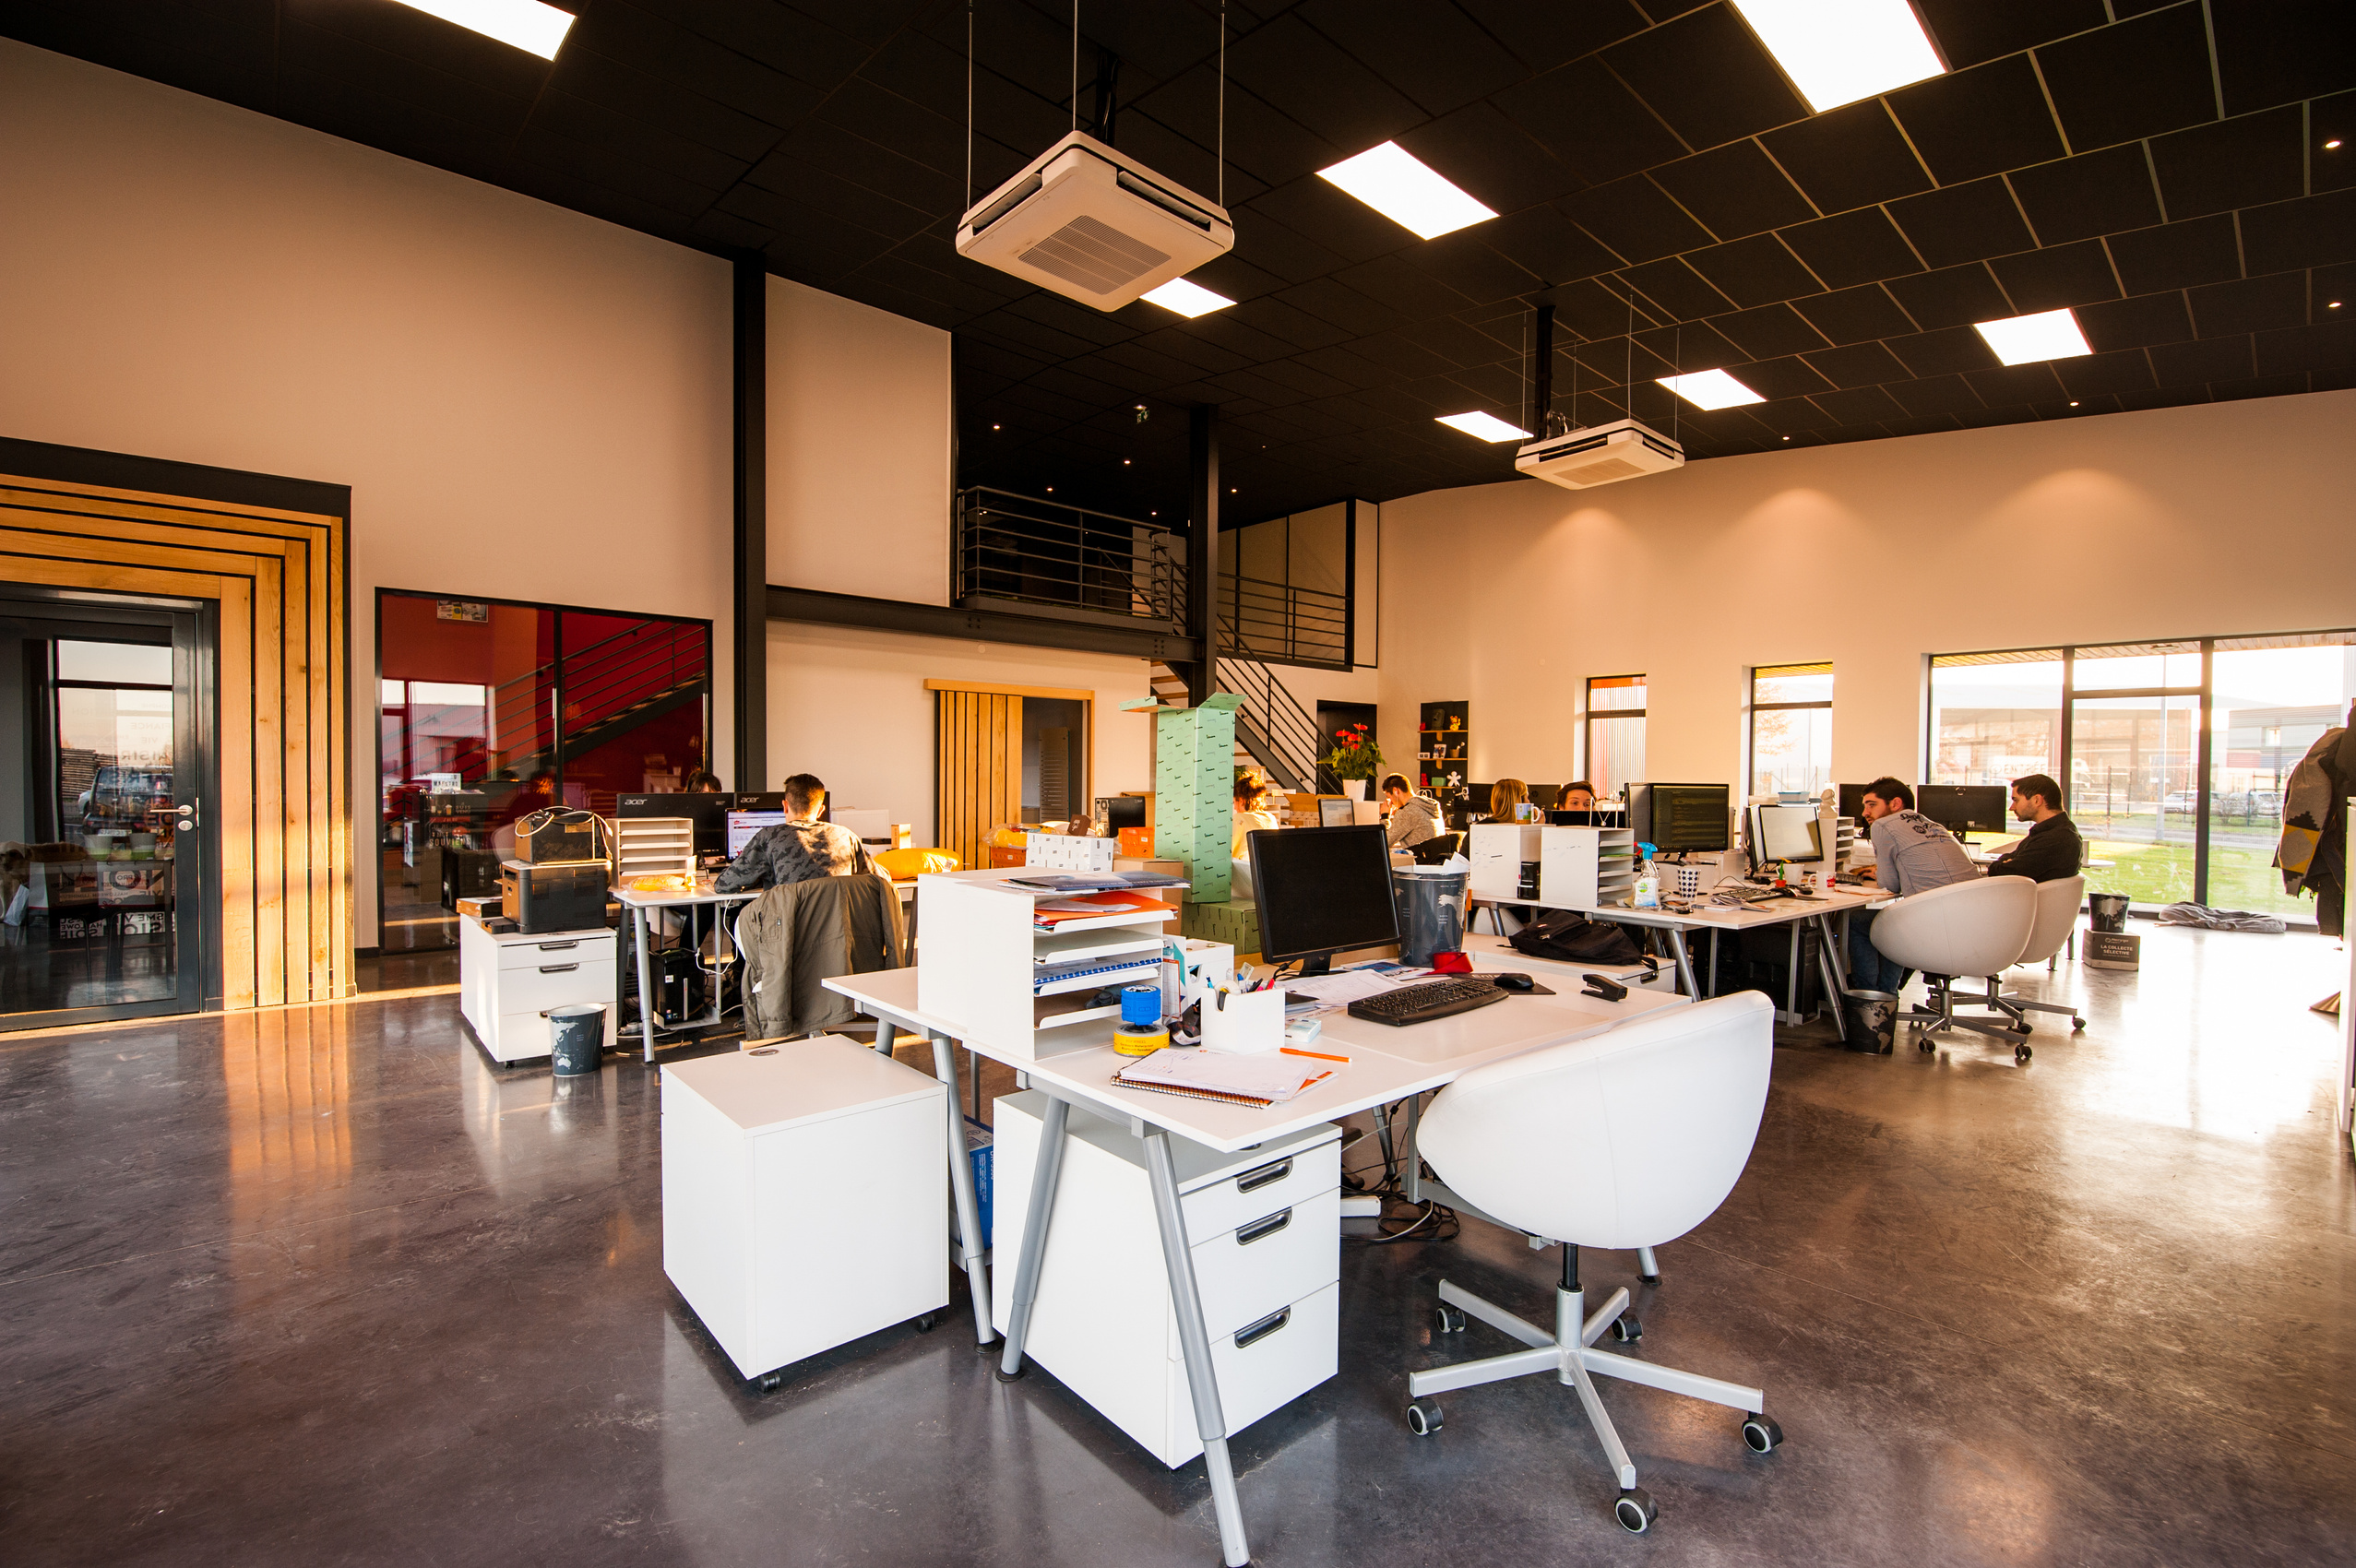
Setting the Tone for Excellence
Operational Excellence is HOW we do what we do—consistently, professionally, and with a service mindset.
Every action, email, approval, meeting and record contributes to IITA’s results.

Slide 15

Module One
Operational Excellence at IITA:
Role of Administrative Professionals in Supporting Research Excellence

Slide 16
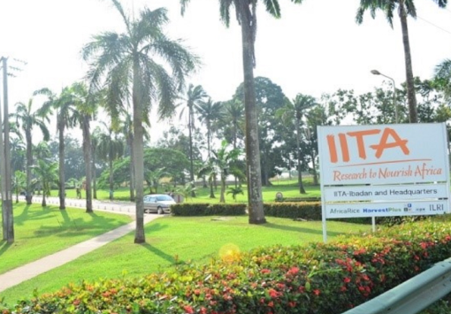
LET’S BREAK IT DOWN TO IITA
  Supporting scientific innovation through efficient administrative systems
  Ensuring timely execution of research processes
  Maintaining compliance with institutional and donor requirements
  Promoting collaboration between administrative and research teams

Slide 17

WHY ADMINISTRATIVE PROFESSIONALS MATTER IN IITA
ADMINISTRATIVE PROFESSIONALS:
  Serve as operational backbone of research activities
  Enable researchers to focus on scientific innovation
  Manage logistics, documentation, and coordination
  Maintain institutional standards and compliance
  Facilitate communication across departments and stakeholders

Slide 18

THE ADMIN PROFESSIONAL AS A STRATEGIC PARTNER
Administrative professionals contribute by:
  Anticipating researchers’ needs
  Providing proactive support
  Coordinating project timelines
  Supporting grant and funding processes
  Managing stakeholder communication

Slide 19

KEY AREAS ADMIN PROFESSIONALS SUPPORT RESEARCH EXCELLENCE
2. Documentation and Compliance
Admin professionals help ensure:
  Accurate record keeping
  Compliance with research protocols
  Proper documentation for audits and donor reporting
  Organized filing systems
Best Practices:
  Standardize documentation processes
  Maintain confidentiality and data integrity
  Regularly review and update records
1. Communication and Coordination
Effective communication involves:
  Clear and accurate information sharing
  Managing internal and external communication
  Scheduling and coordinating meetings
  Supporting collaboration across multidisciplinary teams
Best Practices:
  Maintain communication logs
  Confirm instructions and expectations
  Provide timely updates

Slide 20
KEY AREAS ADMIN PROFESSIONALS SUPPORT RESEARCH EXCELLENCE
3. Resource and Logistics Management
Responsibilities include:
  Managing procurement processes
  Coordinating travel and event logistics
  Tracking inventory and supplies
  Supporting laboratory and field operations
Best Practices:
  Plan ahead and anticipate resource needs
  Maintain vendor relationships
  Track and monitor requests efficiently
  Stakeholder Engagement
Administrative professionals interact with:
  Researchers and scientists
  Donors and partners
  Vendors and service providers
  Internal departments
Best Practices:
  Demonstrate professionalism and responsiveness
  Manage expectations effectively
  Provide consistent service experience

Slide 21
KEY AREAS ADMIN PROFESSIONALS SUPPORT RESEARCH EXCELLENCE
  Time and Workflow Management
Admin professionals help by:
  Prioritizing tasks effectively
  Supporting project timelines
  Managing competing deadlines
  Streamlining administrative processes
Best Practices:
  Use task management tools
  Break projects into manageable steps
  Monitor progress regularly

Slide 22

COMMON CHALLENGES ADMIN PROFESSIONALS FACE
STRATEGIES FOR OVERCOMING CHALLENGES
  Managing multiple priorities
  Communication gaps between teams
  Resource limitations
  Handling urgent or last-minute requests
  Navigating complex compliance requirements tasks due to missing information
  Strengthen communication channels
  Develop standard operating procedures
  Use technology for workflow efficiency
  Build strong working relationships
  Practice continuous learning and improvement

Slide 23

WHY WE SHOULD BUILD A CULTURE OF OPERATIONAL EXCELLENCE HERE @ IITA
  Encourage collaboration across departments
  Promote accountability and ownership
  Support continuous improvement initiatives
  Recognize and celebrate administrative contributions

Slide 24
REMEMBER
Operational excellence is not achieved by systems, policies, or strategies alone—it is ultimately driven by attitude. The most effective organizations are built on individuals who approach their work with ownership, discipline, and a commitment to doing things right, even when no one is watching.
This means showing up each day with the intention to add value, improve processes, collaborate effectively, and take responsibility for outcomes.
When employees cultivate this mindset, routine tasks become opportunities for improvement, challenges become learning moments, and service delivery becomes more consistent and reliable. Excellence then stops being an occasional achievement and becomes the standard way of working.

Slide 25


SERVICE MINDSET IN RESEARCH SUPPORT
“Think about a time when you needed urgent support at work. What kind of response did you hope for?”
Service Mindset
Notes:
Instructions:
• Take 4–5 responses
• Write keywords on flipchart (e.g., fast, helpful, clear, respectful)
Facilitator Link:
• “That expectation you had—that is exactly what researchers expect from us.”
• “Today, we’re talking about how to consistently deliver that experience through a service mindset.”

Slide 26

What is a Service Mindset?
A service mindset is the intentional commitment to support researchers, partners, and stakeholders effectively, proactively, and professionally—ensuring their work runs smoothly and successfully. In order words, you see them as your customers
Key Question:
“How can I make this researcher’s work easier, faster, and more effective?”
Notes:
A Service Mindset in Research Support, especially for an administrator at IITA goes beyond just completing tasks—it is about intentionally enabling research success through proactive, responsive, and thoughtful support.
Put simply:
It is the attitude of seeing researchers, partners, and stakeholders as customers and consistently asking:
“How can I make their work easier, faster, and more effective?”

Slide 27

WHY DOES SERVICE MINDSET MATTER TO US -
  Research depends on timely and accurate administrative support
  Delays or errors can affect funding, timelines, and outcomes
  Strong support helps accelerate agricultural impact and innovation

Slide 28
Core behaviours of a service-minded administrator
Ownership
Proactiveness
Accuracy
Responsiveness
Empathy
Collaboration
Notes:
Core Behaviours
Walk through each behaviour with quick explanations and examples:
1. Ownership
• “Don’t pass problems—help solve them.”
• Example: Following up instead of saying ‘that’s not my department’
2. Proactiveness
• “Think ahead.”
• Example: Reminding researchers of deadlines before they ask
3. Accuracy
• “Details matter.”
• Example: Double-checking figures, names, and compliance requirements
4. Responsiveness
• “Acknowledge quickly—even if you can’t complete immediately”
• Example: “I’ve received this; I’ll revert by 2pm”
5. Empathy
• “Understand the pressure researchers are under”
• Example: Prioritizing urgent grant submissions
6. Collaboration
• “Work across teams to get results”
• Example: Coordinating with finance/procurement to avoid delays

Slide 29

Mini Activity
Activity: “Say It Better” - From Transactional to Service Mindset
Researcher says:
“I need this processed urgently.”
Typical Response (to improve):
“Your document is incomplete. Fix it.”
Question for Participants:
  “How can we say this with a service mindset?”
Notes:
Call a few participants to respond before showing them the next page.

Slide 30

Mini Activity
Activity: “Say It Better” - From Transactional to Service Mindset
“I’ve highlighted a few missing details—once updated, I’ll process it quickly so we meet the deadline.”
Note -
  “Same message, different mindset.”
  “Service mindset improves both results and relationships.”

Slide 31

KEY Takeaway
Service Mindset = Intention + Ownership + Excellence + Empathy
Remember -
  Every email, every document, every interaction is an opportunity to demonstrate this mindset.
  The question is—what experience are you creating for the researcher?

Slide 32
CASE STUDY: “THE DELAYED APPROVAL”
Scenario:
A researcher submits a request for procurement approval 3 days before a deadline.
The administrator notices:
  Missing budget code
  Incorrect figures
  Incomplete documentation
The administrator is also busy and decides to delay response.
Outcome:
  Deadline is missed
  Researcher is frustrated
  Blame is placed on admin team

Slide 33
CASE STUDY: “THE DELAYED APPROVAL”
Group Task ( Discuss):
  What went wrong?
  Which service mindset behaviours were missing?
  What should the administrator have done differently?
  How could this situation be prevented in future?
Each Group has 07 minutes to disccuss, and 02 minutes to each present.
Notes:
Expected Insights
Participants should identify:
• Lack of responsiveness
• Lack of proactiveness
• Poor ownership
• Weak communication
Facilitator Reinforcement
• “Even when work is incomplete, how we respond matters.”
• “Delay without communication is one of the biggest service failures.”

Slide 34
Key Takeaways
  Administrative professionals are essential to IITA’S research success
  Operational Excellence requires collaboration and consistency
  Proactive service improves research productivity
  Continuous improvement strengthens institutional performance
Service Mindset = Intention + Ownership + Excellence + Empathy

Slide 35

Personal Action Plan
Participants should reflect on:
  One area they can improve immediately
  One new skill they want to develop
  One strategy they will apply to support research excellence

Slide 36
Session Close
Core Message:
Operational Excellence begins with a simple but powerful decision: to approach every task with intention, professionalism, and the determination to do it exceptionally well.

Slide 37

Comments? Questions?

Slide 38

Module Two
PROCESS EFFICIENCY & WORKFLOW OPTIMIZATION
Streamlining how we work for consistent, high-quality outcomes

Slide 39
Process =
What must happen (the structured steps).
Workflow =
How it happens in real life (the movement of tasks/information).
One-Sentence Summary
A process gives the rules; a workflow shows the actual path the work follows.
Notes:
Facilitator Note:
Link to IITA’s research environment—administrators are “process enablers.”

Slide 40
COMPONENTS OF TEAMWORK
PROCESS
How do we get to where we want to.
Wasted Effort
TASK
Your purpose, what you are doing.
the amazing team
How?
what?
Low Productivity
RELATIONSHIP
How members interact with one another.
Lack of Efficiency
Who?

Slide 41
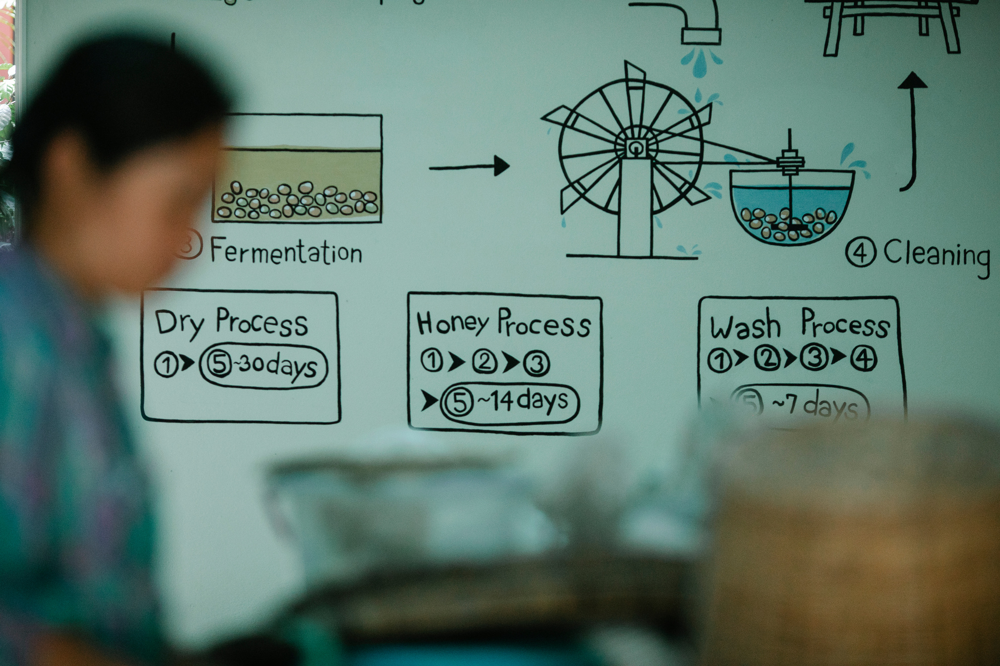
Why Process Efficiency Matters
Reduces delays and duplication
Improves consistency in admin work
Strengthens accuracy and compliance
Frees up time for higher-value tasks
Supports research & donor-funded projects
Notes:
Facilitator Note:
Link to IITA’s research environment—administrators are “process enablers.”

Slide 42
What Is a Workflow?
A workflow is the step-by-step sequence of activities required to complete a task.
Simple Example:
Staff Member Initiates Request
Supervisor Reviews & Approves
Budget/Finance Verification
Records Are Filed. Traveler Receives Final Travel Pack
Travel Desk Books Tickets & Accommodation
Admin Confirms Travel Logistics Requirements
Key Principle:
If people follow different steps for the same task → inconsistencies and errors occur.

Slide 43

Common signs of inefficient processes include:
  Slow or unclear approvals
  Rework (doing the same task twice)
  Missing or incomplete information
  Bottlenecks with specific individuals
  No standard templates
  Too many manual steps
  Conflicting instructions from different units
Identifying Inefficiencies

Slide 44
IITA Administrative Processes (Examples)
These will guide the mapping activity:
  Procurement support (request → vendor → approval → delivery)
  Travel logistics (request → booking → clearance → reporting)
  Meeting & event setup (request → preparation → coordination)
  Training/workshop coordination
  Documentation & correspondence handling
  Visitor & stakeholder reception
  Records and filing processes
  Station/departmental reporting
ACTIVITY
Select one of these processes to map

Slide 45
The Goal of Process Mapping
Highlight unclear or unnecessary steps
Make work visible
Show risks and points of error
Clarify who does what and See where people overlap
Create a path toward improvement
Identify hidden delays
You cannot improve what you cannot see.

Slide 46
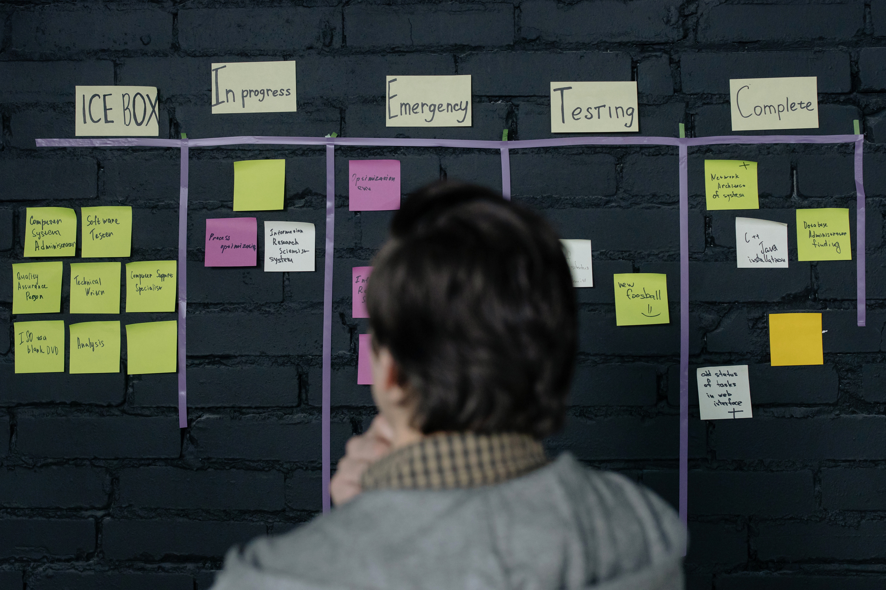
Components of a Good Process
A high-performing process has:
  Clear starting point
  Defined responsibilities
  Minimum number of steps
  Standard templates/forms
  Clear communication checkpoints
  Monitoring and documentation
  Accountability at each stage
  Logical sequence

Slide 47
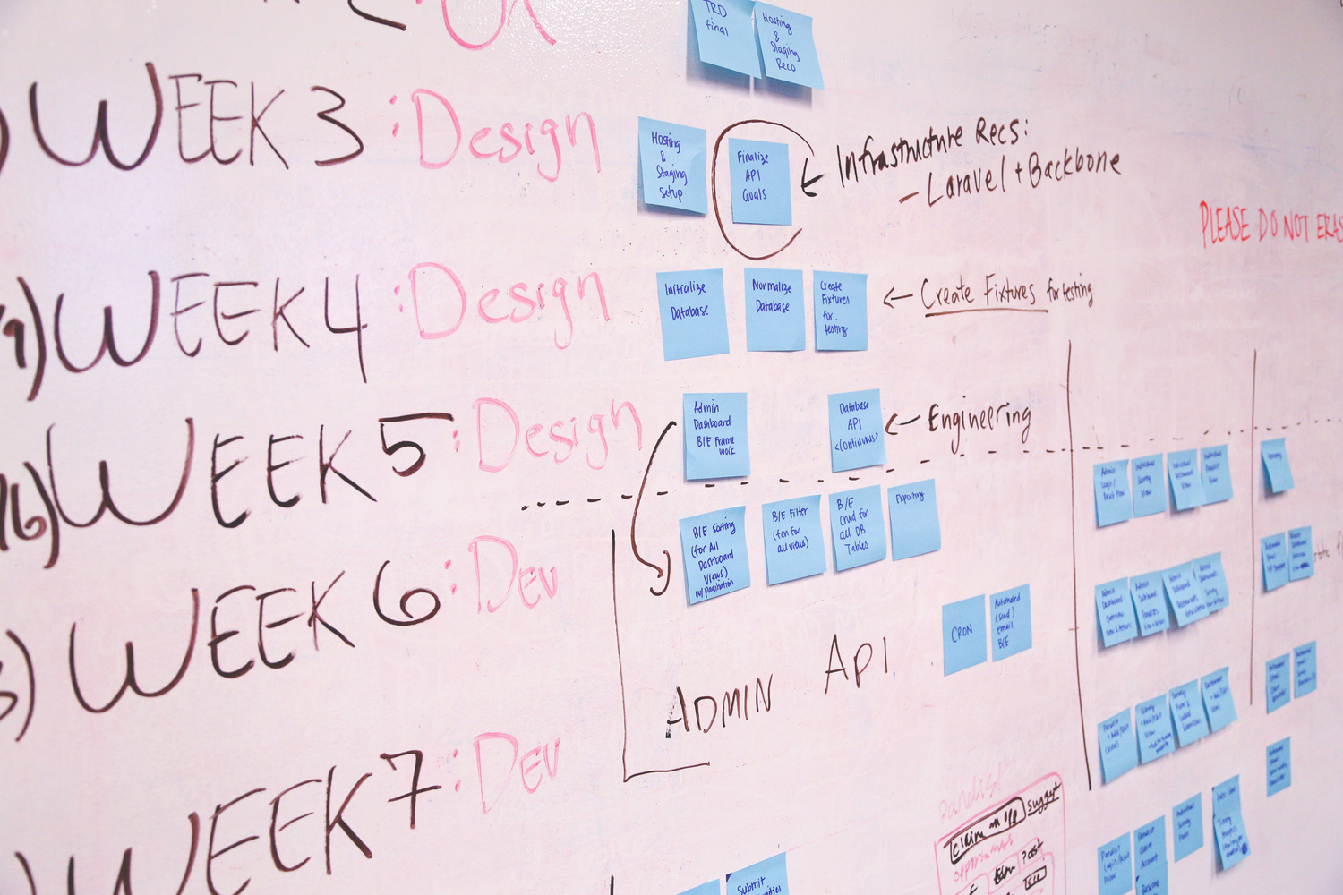
COMMON CHALLENGES IN IITA WORKFLOWS
Miscommunication with researchers and vendors
Difficulty accessing required documents
Waiting for approvals
Repeating tasks due to missing information
File versions not properly tracked
Lack of updated SOPs
Different units working in silos
Inconsistent email or follow-up practices

Slide 48
What Does an Efficient Workflow Look Like?
Faster turnaround time
Fewer steps, less complexity
Clear roles & responsibility
More predictability and stability
Better communication flow
Reduced errors
Easier handover
Notes:
Here is a polished, vivid, facilitator-ready “ideal experience” narrative you can read out or place on a slide. It helps participants clearly imagine what an efficient workflow looks and feels like.
Painting the Picture of the Ideal Administrative Experience at IITA
Imagine this…
You walk into the office in the morning and everything you need to begin your day is already clear.
Your tasks are organised, your priorities are set, and you are not starting the day firefighting or searching for missing information.
A researcher sends you a request — and the information is complete.
No back-and-forth emails.
No guessing.
No chasing for details.
Approvals come in on time because the process is clear and everyone understands their role.
You know exactly what happens next, who is responsible, and how long it should take.
When you communicate with a colleague in another unit, the response is timely and professional.
There is no confusion, no duplication of effort, and no conflicting instructions.
Everyone is speaking the same “operational language.”
Your workflow feels smooth and predictable.
Documents are easy to find.
Templates are standardised.
Meetings and events run without last-minute panic.
You are not stretched thin or overwhelmed.
Instead, you feel organised, calm, and in control — with enough time to focus on higher-value tasks rather than being stuck fixing avoidable errors or chasing missing pieces.
Your work becomes more accurate, reliable, and respected.
Researchers trust your processes.
Managers appreciate your efficiency.
You feel proud of the value you add to IITA’s mission.
This is the experience we are working towards today:
A work environment where processes support you — not stress you.

Slide 49
Group Exercise — Process Mapping
Task:
In groups, select one administrative process commonly used at IITA (e.g., procurement, travel, meeting setup).
Steps:
  Write down the current steps as they happen now
  Note the people involved (“who touches what”)
  Identify bottlenecks, delays, errors, or confusion points
  Discuss what should change to make the process better

Slide 50
Group Output Template
Proposed Improvements:
  Steps to remove or combine
  Approvals to shorten
  Templates or checklists needed
  Communication improvements
Each group should prepare:
1. Current Workflow (As-Is)
  Step 1 → Step 2 → Step 3…
2. Identified Issues
  What slows the process?
  Where do mistakes happen?
  What causes delays?
This will feed into the “Continuous Improvement” session on Day 2.

Slide 51
Debrief Discussion
  Which processes took the longest steps?
  What steps were unnecessary?
  Where were the main breakdowns?
  What practical solutions did your group suggest?
  What can be implemented immediately?

Slide 52
Key Insights
  Visibility reveals inefficiencies
  Processes often grow complicated over time
  Small improvements = big impact
  Workflow discipline affects service quality
  Everyone has a role in improvement

Slide 53
Session Close
Core Message:
Efficiency is not about working harder; it is about creating processes that allow us to work smarter, faster, and with less stress.

Slide 54
Comments? Questions?

Slide 55

Module Three
Time & Priority Management in a Research Environment
Managing Multiple Demands in a Research Environment

Slide 56
Reality Check — IITA Work Environment
Administrators’ roles often involve:
Managing multiple simultaneous projects
Working with strict compliance and reporting requirements
Collaborating across departments and stakeholders
Handling unpredictable deadlines
Maintaining high accuracy and credibility standards
Key Insight:
Being busy does not always mean being productive. Productivity is not measured by activity level but by results and quality output.
Notes:
“Let’s start with your reality.
Research environments are fast-paced and often unpredictable. You are dealing with researchers, finance teams, donors, and internal stakeholders—all with different expectations.
Let me ask you—what makes your role particularly demanding?”
(Allow responses)
“Thank you. What this shows is that being busy is normal—but being effective requires intention.”

Slide 57
Common Time Management Challenges
Participants can relate to:
Multiple competing priorities
Email and meeting overload
Frequent interruptions
Poor task planning
Difficulty delegating responsibilities
Underestimating review time
Notes:
Here are some common challenges many professionals face—interruptions, last-minute requests, and trying to do too many things at once.
Which of these do you personally struggle with the most?”
(Engage participants briefly)
“The first step to improving is recognizing where the gaps are.”

Slide 58
UNDERSTANDING PRIORITY VS URGENCY
The Priority Matrix (Eisenhower Matrix)
 | URGENT (Needs immediate attention) | NOT URGENT (Can be scheduled)
IMPORTANT (Adds value, impacts goals) | 🔴 Q1: Do Now | 🟢 Q2: Plan
NOT IMPORTANT (Low value) | 🟡 Q3: Delegate | ⚪ Q4: Eliminate
The Priority Matrix helps you decide what to do first, what to plan, what to delegate, and what to avoid.

Slide 59
🔴 QUADRANT 1: URGENT + IMPORTANT (DO NOW)
🟢 QUADRANT 2: IMPORTANT + NOT URGENT (PLAN)
These are critical tasks that must be handled immediately.
At IITA, examples include:
  A system outage affecting research data access
  An urgent donor report due today
Key Insight:
  You cannot avoid these, but if too many tasks fall here, it means poor planning.
  These are high-value tasks that don’t need immediate action—but are critical for long-term success.
At IITA, examples include:
  Planning research projects and field trials ahead of season
  Staff training and capacity building
Key Insight:
  This is the MOST IMPORTANT quadrant for success.
  Strong organizations like IITA thrive when they invest here.

Slide 60
🟡 QUADRANT 3: URGENT + NOT IMPORTANT (DELEGATE)
⚪ QUADRANT 4: NOT URGENT + NOT IMPORTANT (ELIMINATE)
These tasks feel urgent, but they don’t add much value to your core goals.
At IITA, examples include:
  Constant phone calls or emails that interrupt deep work
  Routine meeting requests without clear agenda
Key Insight:
These tasks steal your time if not managed.
Best action: Delegate, automate, or streamline
  These are time-wasters with little or no value.
At IITA, examples include:
  Excessive gossip or idle office discussions
  Spending too much time on non-work-related social media
Key Insight:
  These reduce productivity and should be minimized or eliminated.

Slide 61
LET’S TAKE A LOOK AT REAL-LIFE IITA SCENARIO
In what order would a high-performing officer prioritize his day?
A
B
C
D
Repeated admin calls about transport bookings →
Upcoming grant proposal (due next month) →
Scrolling WhatsApp during work hours →
Morning crisis: Irrigation system fails in trial field →

Slide 62
SITUATION: A RESEARCH OFFICER’S DAY
A. (D) Morning crisis: Irrigation system fails in trial field → 🔴 Q1
B. (B) Upcoming grant proposal (due next month) → 🟢 Q2
C. (A) Repeated admin calls about transport bookings → 🟡 Q3
D. ( C) Scrolling WhatsApp during work hours → ⚪ Q4
A high-performing IITA officer will:
  Fix the irrigation issue immediately
  Block time later to work on the proposal
  Delegate transport coordination
  Avoid distractions
Most people spend their time in:
🔴 Q1 (firefighting) and
🟡 Q3 (distractions disguised as urgency)
But the most effective professionals at IITA focus on:
🟢 Q2 (planning, prevention, growth)

Slide 63
Consequences of Poor Priority Management
Missed deadlines
Increased errors and rework
Reduced research credibility
Burnout and stress
Institutional reputation damage

Slide 64
Practical Workflow (Daily Use)
When a task comes in, ask yourself:
  Is this important to my goals or IITA’s mission?
  Is this urgent right now?
Then decide:
If YES + YES → Do
If YES + NO → Plan
If NO + YES → Delegate
If NO + NO → Eliminate
Key Insight:
Productivity is not just about doing more—it’s about doing what matters most, at the right time, in the right way.

Slide 65
“Let’s start with a simple question—how many of us have had a day where we were busy from morning till evening, but still felt we didn’t achieve much?”
“Busy vs Productive”
Participants should share-
  One task they did yesterday
  Whether it was important or just urgent
Write responses on a flipchart under:
  Important
  Urgent
  Both
  Neither
“Being busy is not the same as being effective. Today, we learn how to work with clarity and intention.”

Slide 66
THE FOUR-STEP PRIORITY MODEL
Step 1: Clarify Tasks
Break assignments into manageable
components.
Step 2: Estimate Effort
Allocate realistic time frames.
Step 3: Sequence Tasks
Determine task order based on importance and dependency.
Step 4: Review Progress
Conduct daily and weekly progress assessments

Slide 67
THE Four-Step Priority Model
Step 1.
CLARIFY TASKS
What exactly needs to be done?
“What happens when a task is not clearly defined?”
Task -
“Prepare a workshop.”
“What exactly does this involve?”
If a task is not clear, it cannot be done well.
Notes:
“What exactly needs to be done?”
🔍 What this means:
Many tasks feel overwhelming because they are too broad or unclear.
Clarifying tasks means:
Breaking big assignments into specific, actionable steps
Removing ambiguity
Knowing where to start
🧠 IITA Examples:
❌ Unclear Task:
“Prepare for donor visit”
✅ Clarified Tasks:
Confirm date and time of visit
Prepare visitor itinerary
Coordinate transport and accommodation
Ensure meeting room setup
Print briefing documents
Liaise with research team for presentations
💡 How to Do It:
Ask:
What are the exact deliverables?
What steps are required?
Who is involved?
What resources are needed?
⚠️ Common Mistake:
Jumping into execution without clarity → leads to:
Errors
Rework
Missed steps

Slide 68
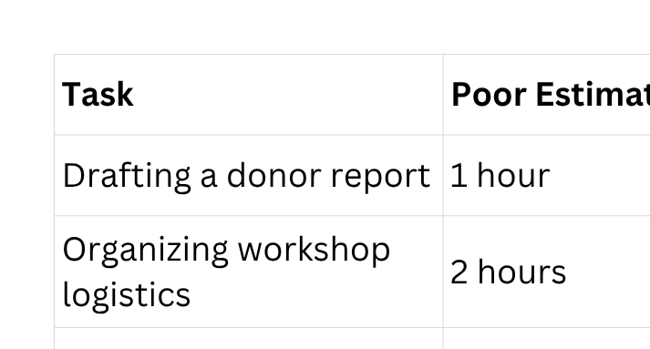
The Four-Step Priority Model
Step 2:
Estimate Effort
How long will this realistically take
“Why do we often miss deadlines?”
“If a task is not clear, it cannot be done well.”
What gets poorly estimated gets poorly delivered.
Notes:
How to Do It:
Use past experience as a guide
Add buffer time for:
Delays
Approvals
External dependencies
Consider:
Complexity
People involved
Approval layers
⚠️ Common Mistakes:
Underestimating tasks → leads to stress and missed deadlines
Ignoring dependencies (e.g., waiting for approvals)

Slide 69
The Four-Step Priority Model
Step 3: Sequence Tasks
What should come first?
“What should be done first—and why?”
  Send invitations
  Confirm date
  Book venue
  Get approval
  Prepare materials
Order matters as much as effort. Doing the right task at the wrong time is still ineffective.
Notes:
What this means:
Not all tasks can (or should) be done at once.
Sequencing involves:
Deciding task order
Understanding dependencies
Prioritizing based on importance and deadlines
🧠 IITA Example: Workshop Planning
You cannot:
❌ Book travel before confirming dates
❌ Print materials before finalizing content
✅ Proper Sequence:
Confirm workshop date and agenda
Get approval
Book venue and logistics
Send invitations
Prepare materials
Final confirmations
💡 How to Do It:
Ask:
What must happen first?
What tasks depend on others?
What deadlines are fixed?
⚠️ Common Mistakes:
Working on easy tasks first instead of important ones
Ignoring dependencies → causes delays

Slide 70
The Four-Step Priority Model
Step 4:
Review Progress
“How often do you pause to review your work?”
Regularly checking:
What has been completed
What is pending
What needs adjustment
Two Levels of Review
DAILY REVIEW (Short Check – 10–15 mins)
WEEKLY REVIEW (Deep Check – 30–60 mins)
What you don’t review, you cannot improve.
Notes:
What this means:
Regularly checking:
What has been completed
What is pending
What needs adjustment
🧠 IITA Context:
Administrators often juggle:
Procurement
Logistics
Reporting
Stakeholder coordination
Without review → things fall through the cracks
🔁 Two Levels of Review
📅 DAILY REVIEW (Short Check – 10–15 mins)
Ask:
What did I complete today?
What is pending?
What must be done tomorrow?
Are there any blockers?
📊 WEEKLY REVIEW (Deep Check – 30–60 mins)
Ask:
What progress have I made on key tasks?
Am I meeting deadlines?
What needs reprioritization?
What can be delegated or escalated?
💡 IITA Example:
A procurement request is delayed
👉 Weekly review helps you:
Identify delay early
Follow up or escalate
Prevent project disruption
⚠️ Common Mistake:
Working continuously without reflection → leads to:
Missed deadlines
Poor coordination
Last-minute panic

Slide 71
GROUP EXERCISE: CLARIFY & ESTIMATE
CLARIFY & ESTIMATE
SEQUENCING
Scenario:
“You have been asked to organize a Donor Visit to IITA.”
Task:
Part A – Clarify
  Break the task into at least 8–10 specific actions
Part B – Estimate
  Assign realistic timeframes to each task
Scenario:
“You are planning a 3-day training workshop for staff.”
Task:
  Part A - Identify the expected tasks (at least 8-10), e.g., book venue, etc
Instruction:
  Arrange tasks in the correct order
  Identify dependencies
Group Presentation:
Each group deliberates for 7 minutes, and presents briefly (2 mins each)

Slide 72

Personal Commitment:
“Starting from tomorrow, I will…”
  Clarify tasks by…
  Improve estimation by…
  Review my work by…

Slide 73
Session Close
Core Message:
Excellence in administration is not about working harder—it is about working smarter, with clarity, structure, and intention.
So, remember, good planning is about doing things in the right order.

Slide 74
Comments? Questions?

Slide 75
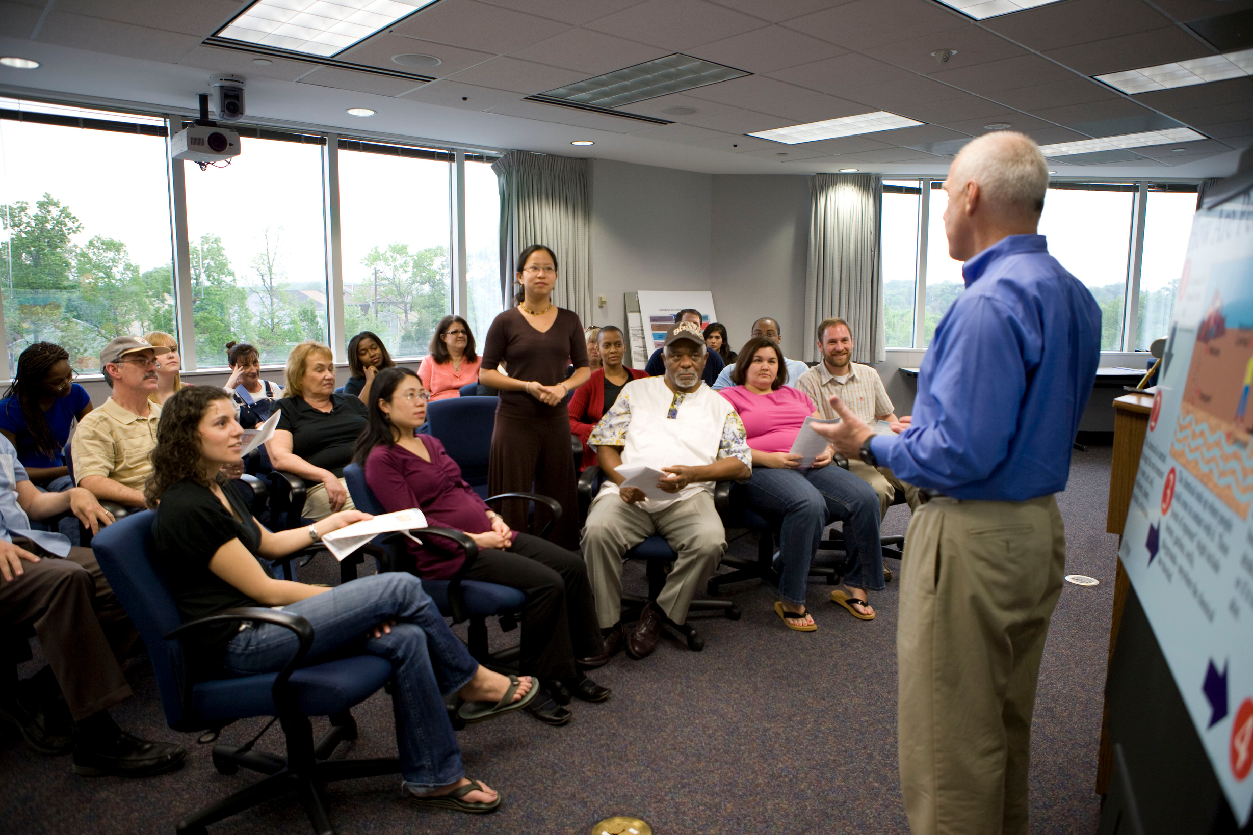
Module Four
PROFESSIONAL COMMUNICATION & STAKEHOLDER ENGAGEMENT
Communicating with clarity, professionalism, and confidence across IITA

Slide 76
WHY COMMUNICATION MATTERS IN OFFICE ADMINISTRATION
Communication defines how people perceive your competence
Poor communication leads to errors, delays, and misunderstandings
Strong communication builds trust with researchers, managers, donors, partners
Admin staff are “information hubs” — everything passes through them
Notes:
Facilitator Note:
Connect communication directly to operational excellence.
How Communication Drives Operational Excellence
Operational Excellence is impossible without excellent communication.
Here is the direct connection:
✅ 1. Clear communication reduces errors
When instructions, emails, and requests are clear, everyone knows exactly what to do — reducing rework, delays, and mistakes.
✅ 2. Timely communication improves workflow speed
Quick acknowledgements, prompt updates, and clear timelines keep processes moving efficiently.
✅ 3. Complete communication supports compliance
Donor-funded environments like IITA require accuracy, documentation, and consistency — all driven by strong communication habits.
✅ 4. Professional communication strengthens stakeholder trust
Researchers, donors, vendors, and colleagues rely on administrators for reliable information.
Good communication equals good reputation.
✅ 5. Effective communication prevents bottlenecks
Missing details, unclear approvals, and unresponded emails are major drivers of operational delays.
✅ 6. Communication ensures accountability
When roles, expectations, and next steps are clearly communicated, everyone knows who is responsible for what.
✅ 7. Communication shapes culture
A culture of politeness, professionalism, and proactive updates enhances teamwork and service quality.
✅ 8. Administrators are the “connective tissue” of operations
They move information between departments — meaning communication is the backbone of their effectiveness.

Slide 77
Who Are Your Stakeholders at IITA?
External Stakeholders
  Donors
  Vendors/suppliers
  Government officials
  Training participants
  Visitors & partners
Internal Stakeholders
  Researchers & scientists
  Station managers & unit heads
  Procurement, HR, Finance
  ICT, Security, Admin
  Interns & junior staff
Every stakeholder requires a different communication approach.

Slide 78
Characteristics of Professional Communication
Known as the 6 C’s of Communication. Effective communication is:
Clear
Concise
Your message is easy to understand, with no ambiguity or confusion.
You say only what is necessary, using as few words as possible without losing meaning.
Courteous
Complete
Your tone is respectful, professional, and considerate of the recipient.
You provide all the information needed for the recipient to take action or make a decision.
Correct
Considerate
Your message is accurate, error-free, and factually reliable.
You adapt your message to the receiver’s needs, background, and perspective.

Slide 79

Common Communication Breakdowns at IITA
Unclear emails or missing information
Late responses or no acknowledgement
Delayed approvals due to incomplete submissions
Incorrect assumptions between units
Misinterpreted tone
Lack of follow-up or documentation
Notes:
Facilitator Note:
Use examples from earlier group discussions.

Slide 80

Communication Standards for Office Administrators
Office administrators should consistently:
  Respond promptly (even if only to acknowledge)
  Share correct, complete information
  Escalate professionally
  Maintain a courteous tone under pressure
  Provide updates proactively
  Keep records of conversations & approvals

Slide 81

Professional Email Standards
Email Is a Formal Record — Write With Intention
Key Principles
  Use clear subject lines that reflect actions required.
  Begin with professional greetings (no “Hi dear,” “Good morning ma,” etc.).
  Keep paragraphs short and focused on one idea.
  Highlight deadlines, expectations, and responsibilities clearly.
  Use institutional tone: precise, factual, courteous, and neutral.
  Always proofread — errors reduce credibility.
IITA Example:
Emailing researchers, donors, or procurement requires accuracy and clarity because decisions depend on your message.

Slide 82

Professional Telephone Call Structure
Purpose: Ensure clarity, efficiency, and a positive stakeholder experience.
1. Preparation
2. Professional Opening
3. State the Purpose Clearly
4. Gather/Share Key Information
5. Action Points & Next Steps
6. Professional Closing
7. Post-Call Follow-Up
Notes:
1. Preparation
Know the purpose of the call
Have documents, facts, and names ready
2. Professional Opening
Greet warmly
Introduce yourself, unit/department, and organization
Confirm you reached the right person
3. State the Purpose Clearly
Briefly describe why you're calling
Link to the stakeholder’s need or context
Avoid long explanations
4. Gather/Share Key Information
Ask focused questions
Provide accurate and concise updates
Confirm understanding consistently
5. Action Points & Next Steps
Clarify tasks, timelines, and who is responsible
Ensure both parties align on expectations
6. Professional Closing
Thank them for their time
Offer further assistance if needed
End the call courteously
7. Post-Call Follow-Up
Document outcomes
Send summary/update if required
Escalate or notify relevant colleagues

Slide 83
Phone Professionalism: The Administrative Standard
Your Voice = Your Professional Signature
  Answer within 3 rings.
  Smile before speaking — it improves tone.
  Identify yourself and your unit immediately.
  Listen fully before responding; do not interrupt.
  Take notes to avoid errors or forgetting details.
  Confirm next steps before ending the call.
Behaviour to Avoid:
  Dropping calls abruptly
  Speaking too fast
  Using informal expressions
  Sounding irritated or rushed
Goal: Every caller should leave with clarity, not confusion.

Slide 84

Virtual Communication Etiquette (Online Meetings & Calls)
Purpose: Promote professionalism and efficiency in digital environments.
1. Prepare & Test Technology
2. Professional Presence
3. Effective Opening
4. Stay Engaged & Structured
5. Manage Digital Tools Well
6. Clarity & Confirmation
7. Professional Closing
Notes:
1. Prepare & Test Technology
Check audio, video, lighting, and internet
Upload required documents ahead
2. Professional Presence
Dress appropriately
Use a clean, distraction-free background
Maintain eye contact through the camera
3. Effective Opening
Greet participants
Introduce yourself and your role
State the meeting purpose and agenda briefly
4. Stay Engaged & Structured
Mute when not speaking
Use clear, concise contributions
Avoid side conversations and multitasking
5. Manage Digital Tools Well
Use “Raise Hand,” chat, or reactions appropriately
Share screen only when prepared
Name documents/files clearly
6. Clarity & Confirmation
Summarize decisions and agreements
Confirm responsibilities and timelines
7. Professional Closing
Recap key outcomes
Appreciate participants
Log off courteously and on time

Slide 85
Managing Expectations Professionally
Set Clear Boundaries Without Sounding Unhelpful
How to manage expectations politely:
  Clarify deadlines and available timelines.
  Explain constraints without excuses.
  Give alternatives if immediate action isn’t possible.
  Communicate delays early — not at the last
minute.
  Offer realistic promises you can deliver.
Helpful phrases:
    “Here is what I can do within today…”
    “To ensure accuracy, I will need until…”
    “May I confirm the priority between these two tasks?”
Outcome: People trust your word when you consistently deliver what you commit to.
EXPERIENCE = EXPECTATION
SATISFIED CLIENT
EXPERIENCE < EXPECTATION DISATISFACTION
EXPERIENCE > EXPECTATION
DELIGHTED CLIENT

Slide 86





Navigating Difficult Conversations
When issues arise:
Stay calm and professional
Focus on the issue, not the person
Use factual language, not emotional language
Offer solutions, not blame
Know when to escalate politely

Slide 87

Handling Difficult Conversations Respectfully
When Emotions Rise, Professionalism Must Rise Higher
Techniques:
  Pause before responding — avoid reactive emotions.
  Ask clarifying questions — understand the issue fully.
  Reframe negative statements into objective issues.
Notes:
Example:
Instead of: “You didn’t send what I asked for.”
Say: “I noticed the document is still pending. What’s the best way we can complete it today?”

Slide 88

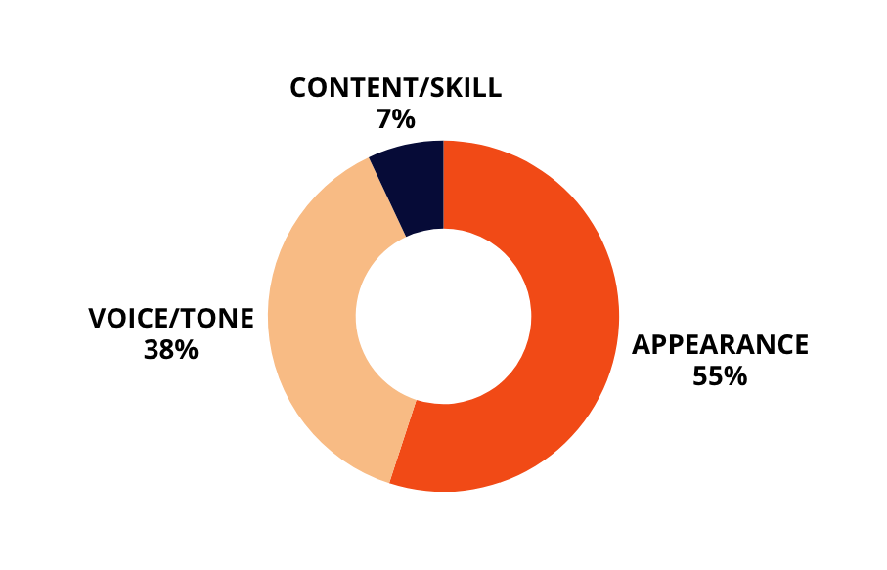
Communication Etiquette
  Don’t send vague messages
  Don’t assume the receiver understands context
  Don’t use accusatory language
  Don’t “forward without explanation.”
Instead:
  Be direct yet polite
  Provide background
  Use bullet points for clarity
  Confirm understanding

Slide 89
The Professional Administrator’s Communication Promise
A commitment every participant should leave with:
  I will communicate with clarity, accuracy, and respect.
  I will represent my unit and IITA with professionalism.
  I will manage expectations honestly and proactively.
  I will address challenges with emotional intelligence.
  I will ensure my communication drives operational excellence.

Slide 90

Stakeholder Engagement Essentials
Stakeholder engagement requires:
  Active listening
  Managing expectations
  Understanding their priorities
  Communicating proactively
  Providing timely feedback
  Showing empathy, especially with researchers under pressure

Slide 91
Role Play Segment (Introduction)
Purpose:
To practice real communication challenges administrators face at IITA.
Instructions:
Participants act out scenarios in pairs or small groups.
Each scenario includes:
Situation
Objective
Challenge
Notes:
ROLE-PLAY COMPETITION MARKING SCHEME (Total: 100 Points)
To be used by facilitators—and optionally, by peer judges if you want added fun.
1. Clarity of Communication – 20 points
Clear message delivery
Logical sequencing
Avoidance of jargon and ambiguity
Scoring Guide:
17–20: Exceptionally clear
13–16: Mostly clear
9–12: Some clarity gaps
0–8: Unclear or confusing
2. Professionalism & Tone – 20 points
Courteous language
Respectful and calm demeanor
Appropriate empathy depending on scenario
Scoring Guide:
17–20: Excellent professionalism
13–16: Generally professional
9–12: Tone needs improvement
0–8: Poor tone/unprofessional
3. Stakeholder Handling – 20 points
Identifies stakeholder needs correctly
Manages conflict or concerns effectively
Maintains control of the conversation
Scoring Guide:
17–20: Outstanding handling
13–16: Good handling
9–12: Average
0–8: Weak handling
4. Communication Structure – 15 points
Assesses adherence to the taught frameworks:
Telephone call structure
Email structure
Virtual communication structure
5 Cs of communication
Scoring Guide:
13–15: Strong structure
10–12: Good structure
7–9: Weak structure
0–6: No clear structure
5. Accuracy & Relevance of Information – 10 points
Provides correct and complete information
Avoids misleading statements
Stays within scope of scenario
Scoring Guide:
9–10: Excellent accuracy
7–8: Mostly accurate
5–6: Incomplete portions
0–4: Largely inaccurate
6. Teamwork & Coordination – 10 points
Smooth transitions between speakers
Equal participation where needed
Clear internal alignment
Scoring Guide:
9–10: Excellent team coordination
7–8: Good teamwork
5–6: Uneven participation
0–4: Poor teamwork
7. Creativity & Practicality – 5 points
Realistic portrayal of IITA work context
Creative problem-solving
Practical and workable solutions
Scoring Guide:
5: Very creative & relevant
4: Good creativity
3: Average
0–2: Low effort
TOTAL: 100 Points
🏆 Optional Fun Add-Ons
You can include:
• Best Communicator Award
(Most articulate individual)
• Best Team Spirit Award
(Group with the best collaboration)
• Most Improved Performance
(For groups that refine their communication style during feedback)

Slide 92
Scenario 1 – Incomplete Request from Researcher
Situation:
A researcher urgently needs travel support but sends incomplete details.
Your Objective:
Obtain missing information politely and efficiently.
Challenge:
Researcher is stressed and expects you to “just figure it out.”
Scenario 2 – Donor Meeting Breakdown
Situation:
A donor arrives for a virtual meeting, but the meeting link was not shared with all recipients.
Your Objective:
Manage the situation professionally and restore trust quickly.
Challenge:
Time-sensitive, high-stakes, pressure scenario.
Notes:
Scenerio 1
Facilitator Note:
Emphasise tone and clarity.

Slide 93
Key Lessons from the Role Plays
  Tone matters as much as content
  Clarity prevents confusion
  Calmness prevents escalation
  Professional boundaries build respect
  Admins act as communication bridges at IITA

Slide 94
Session Close
Core Message:
Professional communication is your power tool — it shapes how you are seen and how smoothly your work flows.

Slide 95
Comments? Questions?

Slide 96

Module Five
Quality & Accuracy in Administrative Excellence
Paying attention to Detail

Slide 97
The Cost of a Small Error
Think about a time when a small mistake caused a big problem at work.
In institutions like IITA, small errors can have big consequences.
Notes:
Trainer Script: “Now that we’ve talked about managing time, let’s talk about the quality of your work.
Because delivering work on time is good—but delivering accurate work is what builds trust.”
“Let’s start with your reality.
Research environments are fast-paced and often unpredictable. You are dealing with researchers, finance teams, donors, and internal stakeholders—all with different expectations.
Let me ask you—what makes your role particularly demanding?”
(Allow responses)
“Thank you. What this shows is that being busy is normal—but being effective requires intention.”

Slide 98
WHY QUALITY & ACCURACY MATTER
At IITA, accuracy is not optional—it directly impacts:
  Research credibility → Wrong data = invalid research
  Funding compliance → Errors can affect donor trust
  Ethical standards → Integrity depends on correctness
  Institutional reputation → Mistakes damage credibility
Discussion Question:
“What is at risk when accuracy is compromised in your role?”
Notes:
Link responses back to real consequences (delays, funding loss, reputational risk)

Slide 99
Common Errors in Institutional Operations
Incorrect dates in reports
Spelling and grammatical errors
Inconsistent formatting
Wrong financial figures
Missing attachments

Slide 100
Common Causes of Errors
Deadline pressure
Multitasking overload
Poor documentation systems
Fatigue and distractions
Lack of structured review processes

Slide 101
Error Investigation Lab
How does this show up at IITA?
What errors does it cause?
How can it be prevented?

Slide 102
Attention to Detail
It involves:
  Verifying data integrity
  Cross-checking documentation
  Reviewing calculations and references
  Ensuring compliance standards
Maintaining consistency in reporting
Notes:
After the activity, ask:
• “Which errors were easiest to spot?”
• “Which ones were missed—and why?”
👉 This drives home the lesson:
“Accuracy requires deliberate attention—not assumption.”

Slide 103
UNDERSTANDING ATTENTION TO DETAIL
Attention to detail means
Verifying accuracy
Cross-checking data
Maintaining consistency
Following procedures
Taking responsibility for completeness
Notes:
Link responses back to real consequences (delays, funding loss, reputational risk)

Slide 104
Attention to Detail Checklist
Before submitting any document:
Are all dates correct?
Are figures accurate?
Is formatting consistent?
Are all attachments included?
Is the document clear and professional?
For the next page, turn to page 35 on your manual

Slide 105
IITA INTERNAL MEMO
Subject: Donor Visit Preparation and Logistics Update
Date: 15th April, 2026
The upcoming donor visit is scheduled to hold on May 25th, 2025, at the IITA Ibadan campus. All administrative and logistics arrangements must be finalized by 20th May, 2026 to ensure smooth coordination.
The expected number of visitors is 15 delegates, including representatives from partner organisations and funding agencies. However, accommodation has currently been reserved for 12 guest at the IITA guest house.
Transportation arrangements includes:
  2 buses for airport pick-ups
  1 SUV for VIP movement
  1 backup vehicle incase of emergency
The workshop session will take place in the Main Conference room, starting at 9:00am and ending at 4:00 PM. All presentation materials should be submitted by May 18th, 2026.
Kindly ensure that all documentations are properly completed and submitted to the Admin Office. Any delay in submission may affect the overall success of the visit.
For further enquires, please contact the Logistics Team.
Prepared by:
Adminstrative Officer
IITA Ibadan
Approved by:
Head of Operations

Slide 106
Errors Embedded:
1. Wrong Dates
  Memo date: 15th April, 2026
  Event date: May 25th, 2025 ❌ (past year)
  Deadline: 20th May, 2026 (inconsistent timeline logic)
2. Spelling Errors
  incase → should be in case
  documentations → should be documentation
  enquires → should be enquiries
  Adminstrative → should be Administrative
3. Inconsistent Formatting
  “9:00am” vs “4:00 PM”
  “Main Conference room” (capitalization inconsistency)
  Mixed date formats (15th March vs April 18th)
4. Incorrect Figures
  15 delegates vs accommodation for 12 guests ❌
  “12 guest” → grammatical + numerical inconsistency
We don’t see what we don’t deliberately check.
Accuracy requires deliberate attention—not assumption.
Notes:
After the activity, ask:
• “Which errors were easiest to spot?”
• “Which ones were missed—and why?”
👉 This drives home the lesson:
“Accuracy requires deliberate attention—not assumption.”

Slide 107
The Quality Mindset Shift
Move from:
Completing tasks quickly
To
Completing tasks correctly and credibly
Have you ever rushed a task and regretted it?
Speed without accuracy creates rework—and rework wastes more time
Notes:
“Have you ever rushed a task and regretted it?”
🎯 Key Insight:
“Speed without accuracy creates rework—and rework wastes more time.”
The Quality Mindset Shift is the transition from merely completing tasks to intentionally delivering excellence. It means moving away from the attitude of “just get it done” to “get it done correctly, professionally, and consistently.”

Slide 108
BUILDING A QUALITY MINDSET
Slow down to get it right
Take ownership of your work
Develop a habit of excellence
Notes:
Link responses back to real consequences (delays, funding loss, reputational risk)
A quality mindset focuses on:
Paying attention to details
Taking ownership of work
Preventing errors instead of correcting them later
Continuously improving processes and outcomes
Understanding that every task affects the organization’s reputation and service delivery
In the workplace, this shift encourages staff to see quality not as an extra responsibility, but as a daily habit and personal standard. It creates a culture where employees aim for accuracy, professionalism, efficiency, and excellence in everything they do.

Slide 109
TECHNIQUES TO IMPROVE ACCURACY
Practical Tools:
  Checklists
  Templates
  Version control
  Scheduled review time

Slide 110
TECHNIQUES TO IMPROVE ACCURACY
Practical Tools:
Use Checklists
Use Templates
Checklists prevent omissions and reduce human error.
A checklist acts as a step-by-step guide to ensure critical tasks are completed before work is submitted.
Templates create standardization and reduce avoidable mistakes.
Templates provide approved formats for recurring tasks so staff do not start from scratch each time.
Practice Version Control
Schedule Review Time
Version control helps prevent confusion and costly mistakes caused by outdated documents.
It means managing document updates clearly so everyone works from the correct version.
Accuracy improves when review is intentional, not rushed.
Build dedicated time to review work before submission.
Use the 3-Step Review Approach: Maker/Checker
Tip: Use a “pause-and-check” habit before clicking send.

Slide 111
Three-Level Accuracy Review Model
Level 1: Self Review
Ensure clarity, completeness, and correctness
Level 2: Peer Review
Independent verification by colleagues.
Level 3: Process Review
Compliance with institutional standard

Slide 112
Three-Level Accuracy Review Model
Level 1: Self Review
Grammar, numbers, completeness
Level 2: Peer Review
Logic, clarity, consistency
Level 3: Process Review
Compliance, format, approval
Quality improves when responsibility is shared

Slide 113
INDIVIDUAL TASK
1. One time management improvement:
(e.g., “I will start tasks earlier”)
2. One quality habit:
(e.g., “I will always do a final review before submission”)

Slide 114
Session Close
Core Message:
At IITA, excellence is not just about getting work done —it is about getting it done right. Accuracy is not extra work; it is the work.

Slide 115
Comments? Questions?

Slide 116

DAY 1 WRAP-UP
Reflections & Key Takeaways

Slide 117
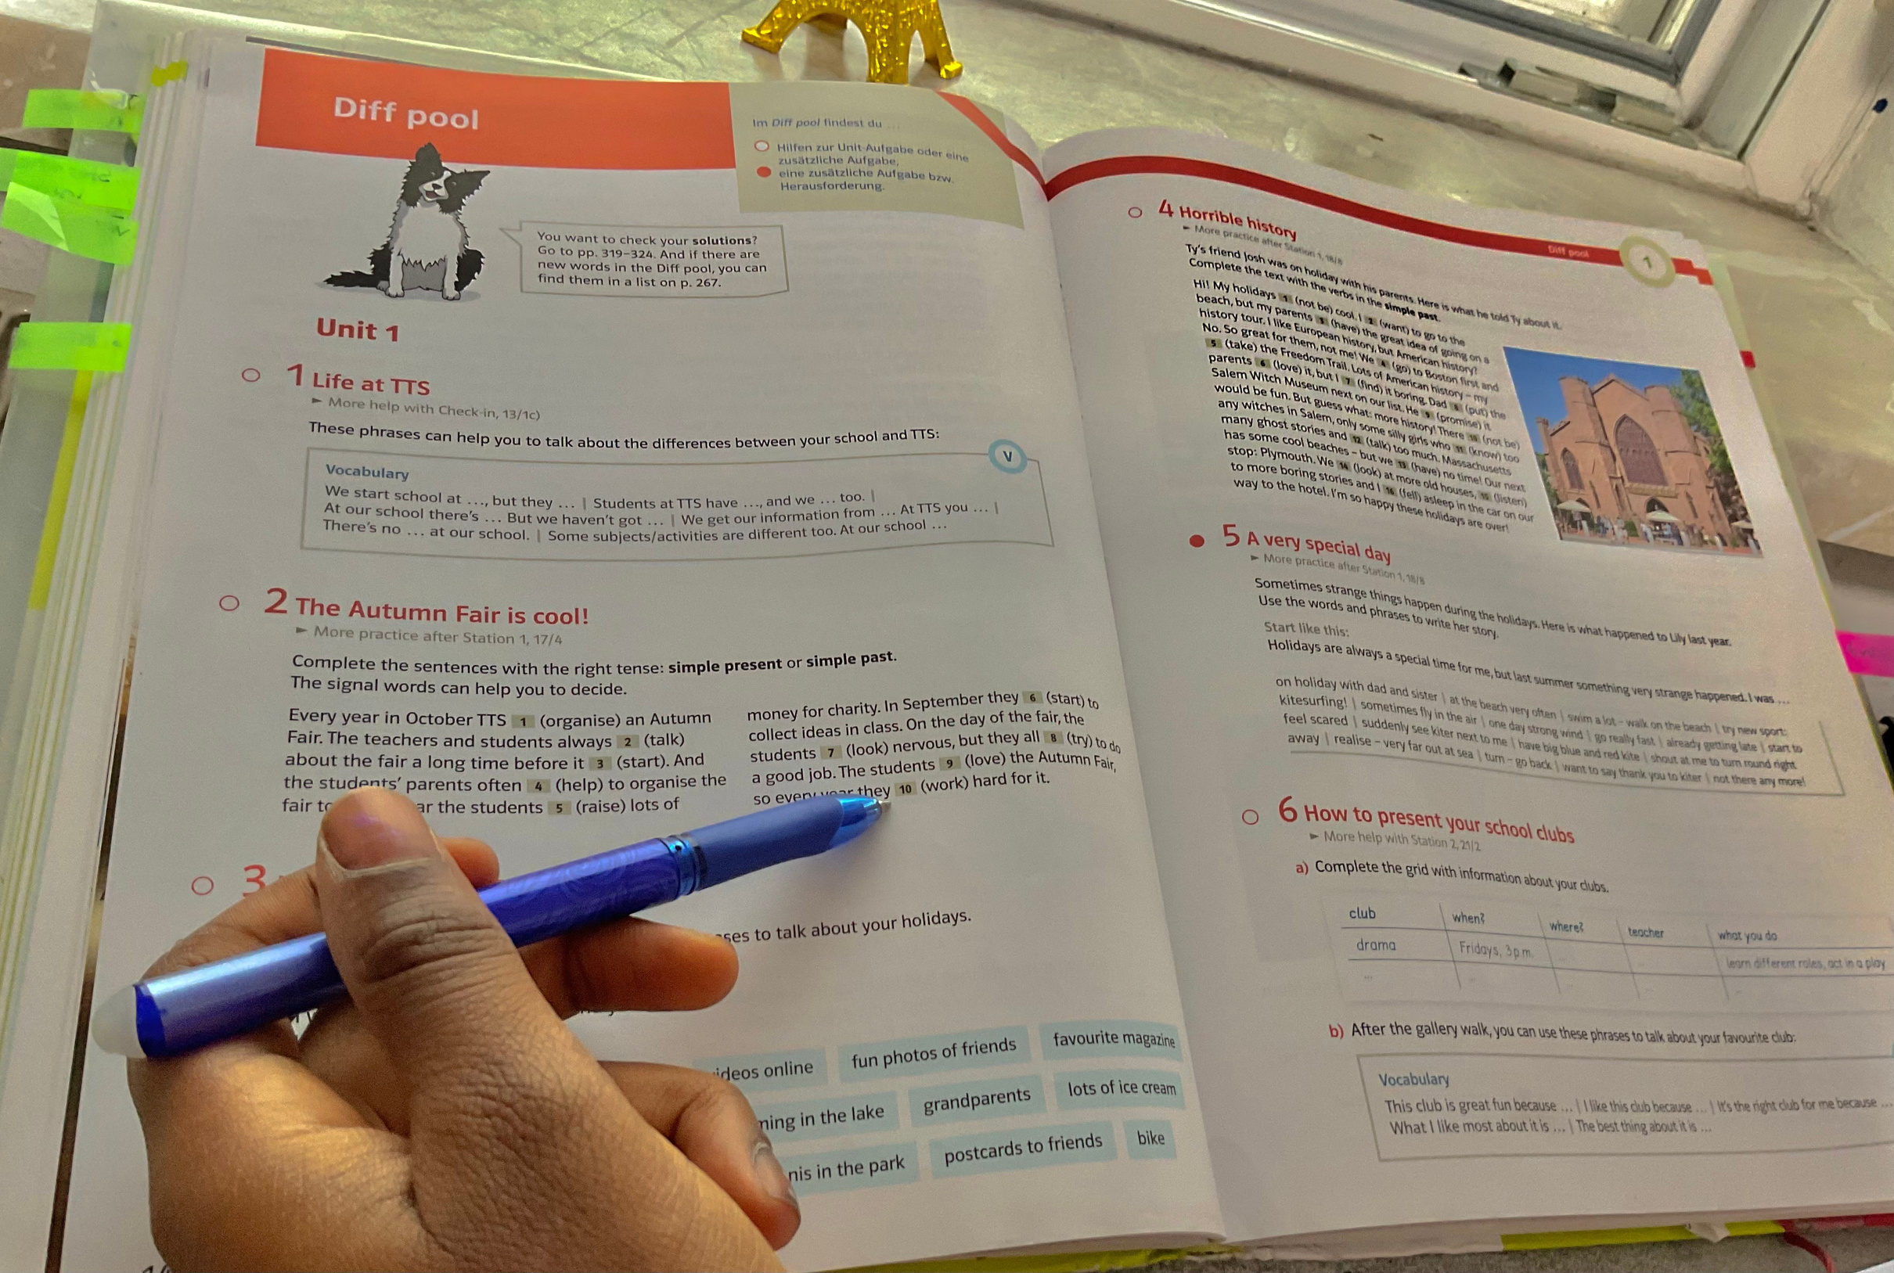
What We Explored Today
  Understanding Operational Excellence
  Foundations of the Administrator’s Mindset
  Process Efficiency & Workflow Optimization
  Professional Identity & Administrative Standards
  Communication Essentials for High-Performance Offices
  Paying attention to details to ensure accuracy

Slide 118
Reflection Prompts
Individual Reflection
Take 2 minutes to reflect:
  What is the most valuable insight you gained today?
  What habit or behaviour do you need to adjust?
  Which tool/framework will you start using immediately?
  What will you share with your team when you return?
Group Debrief
Quick 1-minute responses from volunteers:
  “Something that surprised me…”
  “Something I want to try tomorrow…”
  “One challenge I can now handle better…”

Slide 119
Key Takeaways for Day One
  Introduced the foundations of Operational Excellence—mindset, clarity, and professionalism.
  Mapped key administrative workflows to identify delays, gaps, and improvement opportunities.
  Reinforced the strategic role of administrators in supporting IITA’s research mission.
  Strengthened communication skills for clearer, more respectful, and more accurate stakeholder engagement.
  Closed with practical tools and insights participants can apply immediately to improve daily performance.

